Slide 1
Image Denoising Based on A CNN Model
4105053118 陳謙慶

Slide 2
Introduction
Why Denoising?
In digital image processing, filtering noise to reconstruct a high quality image is an important work for further image processing
Examples: object segmentation, edge detection, recognition,
feature extraction, etc.

Slide 3
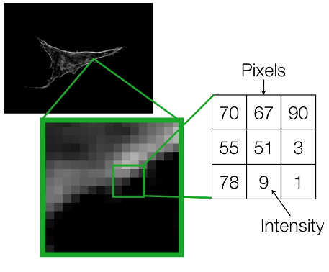
Introduction
For the 2D visual signals, we usually have two forms of filtering which are based on “spatial domain” and “frequency domain”
Spatial domain
modify the value of the pixels
I’(x,y) = T [ I(x,y) ]
Frequency domain
modify the Fourier transformation of
the image
the rate of change of pixel values

Slide 4
How to denoise?
Traditional Denoising Approaches
Average filtering
Wiener filtering
Median filtering
Image Denoising Using Neural Networks
use a CNN model for image denoising

Slide 5
Artificial neural networks
As a classifier for pattern classification in digital image processing
Examples: optical characters recognition (OCR), face detection and recognition, image restoration and reconstruction, image enhancement, etc.

Slide 6
Artificial neural networks
Widely used in image denoising because the networks adapt the nonlinear operations for digital image processing
Effectively applied to image denoising:
pulse coupled neural network models (PCNN)
convolutional neural network models (CNN)
fuzzy neural network models (FNN)

Slide 7
CNN model
Use convolutional layers of a linear CNN model to implement image filtering
Continuously optimizes the weights of convolution kernel during training
Design the linear CNN model to compare with the traditional linear and nonlinear filtering methods

Slide 8
CNN model
Compared with traditional image denoising methods
CNN model:
parameters can be optimized through network training
Traditional Approaches:
the parameters are fixed and cannot be adjusted during the filtering, namely, lack of adaptivity

Slide 9
CNN model
After network training, we get two models which correspond to filter “Gaussian noise” and “salt-and-pepper noise”
Guassian noise
statistical noise having the normal distribution
Salt-and-pepper noise
This noise can be caused by sharp and sudden disturbances in the image signal
It presents itself as sparsely occurring white and black pixels.

Slide 10
Implementation
Implement the CNN model
Added Gaussian noise and salt-and-pepper noise to the test images
Compare the results with traditional filtering methods, for each original image
Use “MSE” to measure the results

